Slide 1

Types of Databases: Technical & Architectural Deep Dive
Databases form the backbone of modern applications, directly impacting scalability, security, performance, and business agility. The right database choice can make or break your architecture.
Palash Bharadwaj
www.linkedin.com/in/Palash

Slide 2




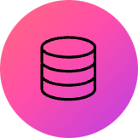

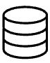
SQL/Relational Databases: The Foundation
Prime Use Cases
Banking systems - Transaction safety and regulatory compliance
ACID Transactions
Strong Security
Healthcare platforms - Patient record integrity and HIPAA compliance
Atomicity, Consistency, Isolation, Durability guarantee data integrity for mission-critical applications.
Mature security features including role-based access, encryption, and audit trails.
ERP systems - Complex business logic across inventory, HR, and finance
MySQL, PostgreSQL, Oracle, SQL Server remain the gold standard for structured, transactional workloads.
Referential Integrity
Foreign keys and constraints ensure data consistency across related tables.

Slide 3



NoSQL Revolution: Document Databases
Schema Flexibility
Horizontal Scalability
E-commerce Catalogs
Adapt to changing requirements without costly migrations. Store varying document structures in the same collection, perfect for agile development cycles.
Scale out across commodity hardware with built-in sharding and replication. Handle massive data volumes with distributed architecture.
Perfect for product catalogs where items have varying attributes. MongoDB and DynamoDB excel at storing complex product hierarchies.

Slide 4


High-Performance Data Storage
Key-Value Stores
Columnar Databases
Lightning-Fast Reads
Analytics Optimization
Sub-millisecond response times make Redis ideal for session management and real-time caching layers.
Column-wise storage and compression deliver 10x faster analytical queries for data warehousing workloads.
IoT Data Ingestion
Real-time Insights
Handle millions of sensor writes per second with horizontal partitioning across distributed clusters.
Cassandra and HBase process massive datasets for customer behavior tracking and business intelligence.

Slide 5


Specialized Database Architectures
Graph Databases
Neo4j, AWS Neptune excel at relationship-heavy data. Fraud detection algorithms traverse connections 1000x faster than SQL joins. Social networks use graph traversal for friend recommendations and influence analysis.
Time-Series Databases
InfluxDB, Prometheus optimize for time-stamped data with automatic downsampling and retention policies. Essential for IoT monitoring, application metrics, and financial market data with high-frequency writes.

Slide 6
Emerging Database Paradigms
Object-Oriented Databases
Spatial Databases
NewSQL Revolution
Oracle Spatial, PostGIS integrate GIS capabilities with topology analysis. Essential for mapping applications, logistics optimization, and urban planning systems.
CockroachDB, VoltDB combine ACID guarantees with horizontal scalability. Ideal for global SaaS platforms requiring both consistency and massive scale.
ObjectDB, ZODB store complex objects with methods, inheritance, and polymorphism. Critical for CAD/CAM systems and engineering simulations requiring object persistence.

Slide 7

Architectural Decision Matrix
Database Type
Strengths
Weaknesses
Primary Use Cases
SQL/Relational
ACID compliance, mature tooling
Limited horizontal scaling
ERP, Finance, Healthcare
Document NoSQL
Schema flexibility, scale-out
Limited ACID transactions
E-commerce, CMS
Key-Value NoSQL
High performance, simplicity
Limited querying capabilities
Caching, Session management
Graph NoSQL
Relationship insights, traversal
Complex query optimization
Fraud detection, Social networks
NewSQL
ACID + horizontal scaling
Technology still maturing
Global SaaS, High-traffic systems
Choose based on workload characteristics, not technology preferences.

Slide 8



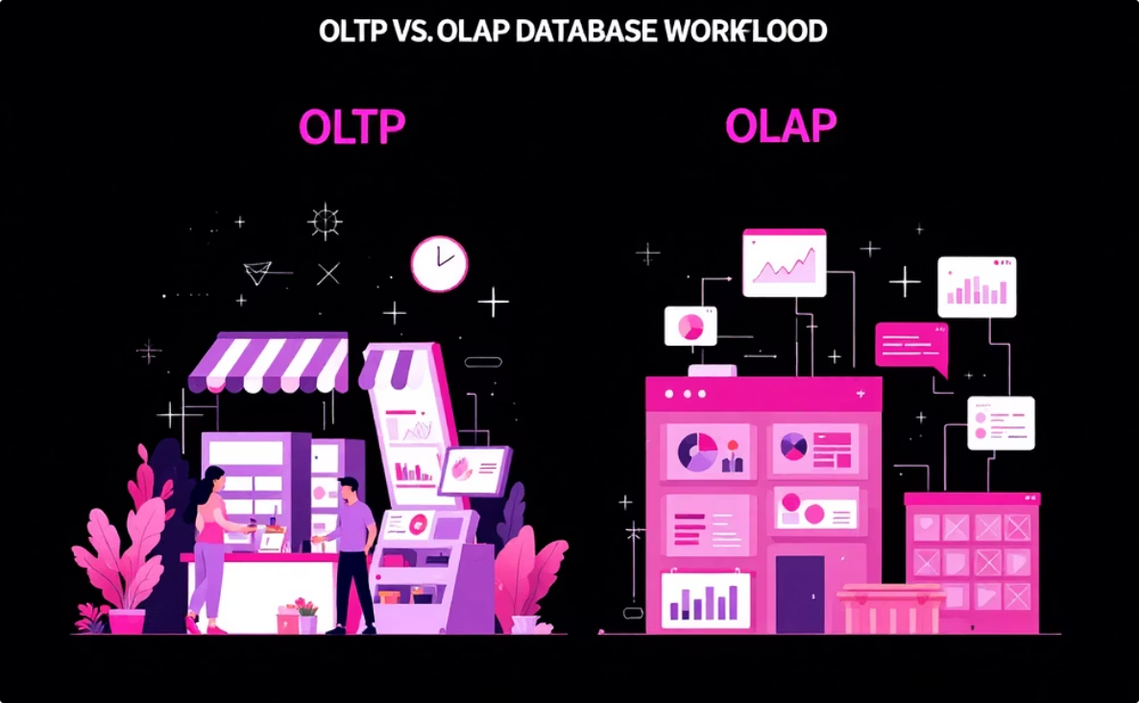
Key Architectural Considerations
Partition Tolerance
CA (Consistent & Available)
AP (Available & Partition-tolerant)
Only Two Achievable
CP (Consistent & Partition-tolerant)
Consistency
Availability
Regulatory Compliance
Infrastructure Strategy
Financial and healthcare sectors often mandate SQL databases for audit trails and data governance requirements, ensuring strict adherence to data governance policies.
Cloud-native applications can fully leverage managed database services for agility and scalability, whereas on-premises deployments demand different optimization and management approaches.
Workload Characteristics
OLTP workloads favor SQL for its consistency in transactions, while OLAP workloads greatly benefit from NoSQL's horizontal scaling and flexible schemas for analytical processing.

Slide 9

Hybrid Architecture: The Modern Approach
Leading organizations adopt polyglot persistence strategies, selecting optimal databases for specific use cases rather than forcing everything into a single solution.
01
Transactional Core
PostgreSQL or MySQL handles ACID-critical business logic, user accounts, and financial transactions with proven reliability.
02
Analytics Layer
Cassandra or ClickHouse processes massive datasets for real-time dashboards and business intelligence workloads.
03
Caching Strategy
Redis accelerates application performance with sub-millisecond response times for frequently accessed data.
04
Search & Discovery
Elasticsearch enables complex text search and recommendation engines across product catalogs and content libraries.

Slide 10

Strategic Recommendations & Next Steps
Database Selection Strategy
Recommended Approach
Audit Current Architecture
SQL: Structured, mission-critical transactions
1
Identify performance bottlenecks and scalability constraints in existing database infrastructure.
NoSQL: Flexible, scalable, unstructured workloads
NewSQL: Global-scale applications requiring ACID + scalability
Run Proof of Concepts
The future belongs to organizations that strategically combine database technologies rather than betting everything on a single solution.
2
Test NoSQL and NewSQL solutions with realistic workloads to validate performance assumptions.
Define Hybrid Strategy
3
Align database choices with business goals and technical requirements for long-term success.
Establish Governance
4
Create compliance frameworks and operational procedures for multi-database environments.

